Slide 1
Case Law Update
Wisconsin Tribal
Judges Association
October 3, 2019

Slide 2
Wisconsin
LCO, LDF, Bad River and Red Cliff suing Governor and local government in federal court asserting that 1854 treaty prohibits the collection of property taxes on reservation land.
Oneida Nation of Wisconsin v. Village of Hobart – 3/28/19, E.D. Wis.
Tribe resisting enforcement of village ordinance requiring event permitting
Turned into reservation disestablishment/diminishment litigation
District court rule reservation had been diminished
On Appeal at the Seventh Circuit
Bad River Band v. Purdue Pharma, Western District
Case stayed in Wisconsin due to multi-district litigation pending in Ohio
Red Cliff Band v. Bayfield County (Zoning ordinance) – Western District
Summary judgment motion pending
Trial scheduled for January 2020

Slide 3
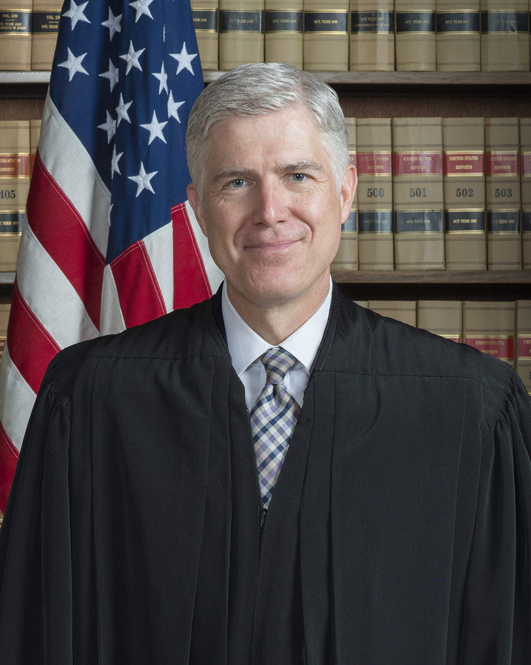
U.S. Supreme Court
Washington State Dep, Department of Licensing v. Cougar Den, Inc., 203 L. Ed. 2d 301 (2019)
Decided, 3/19/19, 5-4 in favor of tribal interests
Herrera v. Wyoming, 203 L. Ed. 2d 846 (2019)
Decided 5/20/19, 5-4 in favor of tribal interests
Both cases involved interpreting treaty provisions: Yakima (taxes), Crow Tribe (hunting); Justice Gorsuch voted with “liberals” in both cases to support tribal interests
Justice Neil Gorsuch

Slide 4
U.S Supreme Court
Herrera v. Wyoming
1868 Treaty between Crow Tribe and U.S. – off reservation treaty rights.
Previously litigated and decided in 10th Cir. Case (Crow Tribe v. Repsis, 73 F.3d 982 (10th Cir. 1995)) which relied on Ward v. Race Horse, 163 U.S. 504 (1896)
When states admitted, treaty rights extinguished; Equal Footing Doctrine.
However, Minnesota v. Mille Lacs Band, 526. U.S. 172 (1999) essentially repudiated Race Horse.
THEN, had to win argument that Bighorn National Forest was “occupied” land and therefore not subject to hunting.

Slide 5
U.S. Supreme Court
Pending for certiorari:
Sequoia Capital Operations v. Gingras (off reservation pay day loan litigation/ arbitration clause issues)
California Trout v. Hoopa Valley Tribe (Clean Water Act)
Oglala Sioux Tribe et al. v. Fleming (South Dakota ICWA enforcement litigation / Younger abstention issue)
Buchwald Capital Adivsors LLC v. Sault St. Marie Tribe of Chippewa Indians (whether the Bankruptcy Code abrogates sovereign immunity of tribes.)

Slide 6
Sault Ste. Marie

Slide 7
Federal Circuit Courts
In re Greektown Holdings, 2019 WL 922658 –
Whether the federal Bankruptcy Code abrogates tribal sovereign immunity
Sault St. Marie tribe owned a state-licensed casino in Detroit, through a sub-entity of the Tribe.
Casino eventually had financial trouble; filed for Chapter 11 Bankruptcy.
Prior to filing, sub-entity had transferred $177,000,000 to Tribe.
Bankruptcy trustee wants to penetrate tribe’s immunity and recover the money as part of bankruptcy and for creditors

Slide 8
Federal Circuit Courts
Did Congress waive Tribe’s sovereign immunity through the Bankruptcy Code?
“Other foreign or domestic government”
NO
Did Tribe waive immunity?
Litigation conduct
Alter ego / sub entity waive
Filing of bankruptcy waives immunity for separate, adversarial fraudulent transfer claims
NO

Slide 9
Federal Circuit Courts - ICWA
Brackeen v. Bernhardt, (August 9, 2019, 5th Cir.)
Challenge to the Indian Child Welfare Act
Arguments by plaintiffs:
Equal protection (racial classification)
10th Amendment (forcing states to carry out federal policy)
Non-delegation (tribes making their own order of preference)
Final ICWA rule (25 CFR 23) – APA challenge
Judgment granted to defendants on all claims
Hon. Reed O’Connor

Slide 10
Federal Circuit Courts - ICWA
What’s next?
Plaintiff states filed motion to extend time for re-hearing
90 days from August 9, 2019 to seek U.S. Supreme Court review
Gorsuch
Last ICWA case at Supreme Court: Baby Veronica case decided against tribal interests (Adoptive Couple v. Baby Girl)
MAJORITY: Alito, Roberts, Thomas, Kennedy (Kavanaugh), Breyer
MINORITY: Kagan, Sotomayor, Ginsburg, Scalia (Gorsuch)

Slide 11
Federal Circuit Courts
Spurr v. Pope, 2019 WL 4009131, Aug, 25, 2019 (6th Cir.)
ISSUE: Does a tribal court have jurisdiction under federal law to issue a civil personal protection order against a non-Indian and non-tribal member in matters arising in the Indian country of the Indian tribe?
HOLDING: Yes, under 18 USC 2265(e).
Tribe and Tribal Supreme Court were out of the case due to sovereign immunity
Trial judge immunity was waived
PPO was a civil, not criminal order

Slide 12
Federal Circuits
Spurr v. Pope
Non-Indian stepmother (Joy Spurr) harassing tribal member stepson.
Stepson seeks personal protection order in Huron Band Tribal Court
Spurr violates order
Spurr sues Tribe, Tribal Court and tribal judge in federal court
18 USC 2265(e) unambiguously grants tribal court jurisdiction over non-Indians, even those with no ties to the reservation.

Slide 13
Federal Circuits
Flandreau Santee Sioux Tribe v Noem, 9-6-19 (8th Cir.)
ISSUE: Whether the Tribe was required to remit state use tax on goods and services sold to nonmembers at the Casino and ancillary convenience store.
HELD: No. IGRA does not pre-empt or disallow tax, but nor does it prohibit it. Court reasoned that under Bracker balancing test, the Tribe and federal government’s interest in raising revenue through gaming and related sales outweighs state’s interest in generalized revenue collection.

Slide 14
Federal Circuits
Knighton v. Cedarville Rancheria, 4/24/19, 9th Cir.
ISSUE: Did Tribal Court have jurisdiction over former tribal administrator who had defrauded the tribe out of significant sums of money?
HELD: Yes. Both Montana exceptions and Water Wheel rule (tribe has independent source of authority based on power to exclude.) supported tribal court jurisdiction even though Tribal Court was created after alleged incidents.

Slide 15
Federal Circuits
Wilson v. Horton’s Towing, 10/9/2018, 9th Cir.
ISSUE: Does a tribal court have colorable jurisdiction to impound a nonmember’s vehicle stopped on a state road within the Reservation after traffic stop for suspected impaired driving?
HELD: Yes. Jurisdiction is colorable even though it is a state road because the impoundment was for possession of marijuana which occurred on tribal land.
DISCUSSION: Useful tool for tribal law enforcement?

Slide 16
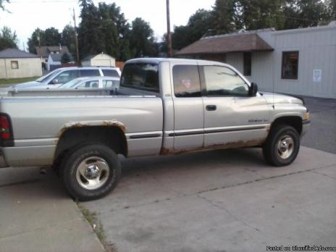
Federal Circuits
Wilson v. Horton’s Towing
1999 Dodge Ram pick up
Lummi officer stopped non-Indian driver for suspicion of impaired driving.
Found marijuana in truck; turned over to state authorities but truck impounded by Tribe.
District court said state road was Indian land
Appellate court said state road is not Indian land BUT:
Prohibition of marijuana on rez is a “direct connection” such that tribal officer had colorable authority for stop and impoundment of truck; unlawful possession of marijuana while on tribal land.

Slide 17
Federal Circuits
Chemehuevi Tribe v. McMahon, 8/19/19, 9th Cir.
ISSUE: Can individual tribal members and the Tribe use 42 USC 1983 to sue sheriff who improperly issued traffic citations to tribal members on reservation?
HELD: Yes for individuals; no for the Tribe. Court says 42 USC 1983 is meant to vindicate individual rights, not Tribe’s rights.
DISCUSSION: Case arises in California; PL 280 issues; 42 USC 1983 authorizes attorney fees

Slide 18
Federal Circuits
Gingras v. Think Finance, et al., 4/24/19, 2nd Cir.
ISSUE: Does federal court have jurisdiction over tribal officers for off-reservation pay day loan activity despite sovereign immunity and despite arbitration clauses in loan agreements?
HELD: Yes; plaintiffs can successfully maintain suit against tribal officers for prospective injunctive relief for violations of state law. (Applying Ex Parte Young theory/reasoning).
DISCUSSION: Montana tribe; cert. pending at U.S. Supreme Court; Court relied on Bay Mills discussion of sovereign immunity; immunity being eroded.

Slide 19
Federal Circuits
The People ex rel. Becerra v. Native Wholesale Supply Company, 7/2/19, (9th Cir.)
ISSUE: Can native-owned cigarette company in New York sell cigarettes to Tribe in California without complying with California statutes regulating cigarettes when cigarettes are then sold to non-Indians in California?
HELD: No.
DISCUSSION: Scheme of transporting cigarettes from NY res, to Canada, to Free Trade Zone to CA reservation does not shield company from compliance with California laws on cigarettes. Over 1 billion cigarettes. About $6-7M in invoices.
OTHER: $4.2M in penalties; $3.8M in atty fees

Slide 20
State Courts
Minnesota v. Ziegler – Unpublished, 2019 WL 4164893
Non-member Indian alleged Red Lake police officers are not “peace officers” under Minnesota Law and that therefore evidence of his impaired driving should be suppressed.
Although Red Lake tribal police officers are not peace officers under MN law, the actions of the tribal police did not rise to the level of an arrest.

Slide 21
State Courts
State v. Roy, Minn. Sup. Ct., 5/22/19
ISSUE: Can a defendant whose state-based probation is revoked for a crime on the Red Lake Reservation be given custody credit for time served in Red Lake incarceration?
HELD: No.
DISCUSSION: Interjurisdictional credit given when the time served is in “connection with” the original crime; Red Lake Reservation is *not* “within the jurisdiction” of Minnesota.

Slide 22
State Courts
Paquin v. City of St. Ignace, Michigan Supreme Court, 7/8/19
ISSUE: Does a federally recognized Indian tribe qualify as a “local government” as that term is used in the Michigan Constitution such that a former tribal official is prevented from running for office due to felony conviction while working for tribe?
HELD: No. Term “local government” is construed narrowly and does not include federally recognized Indian tribe which has inherent sovereignty unlike cities and villages in Michigan.

Slide 23
State Court
In re the Marriage of Stockwell and Dees, 6/27/19, Co. Ct. of App.
ISSUE: Is the legal father (but not biological father) of an Indian child still a “parent” for purposes of ICWA? Is placement of an alleged non-marital child with non-bio father a “child custody proceeding” under ICWA?
HELD: Legal father is not a “parent” for purposes of ICWA. Placement of child with non-bio “father” *is* a child custody proceeding as that term is used in ICWA.

Slide 24
State Courts
Parties divorced in 2013
Husband not excluded and granted custody and placement of child as legal father
Mother brings motion in 2017 that she has DNA test showing another man the father of the child
Trial court had ruled mother’s original motion as untimely (reversed because ICWA allows challenged without time limit)
ICWA definition of parent includes being a biological parent
DISCUSSION: This child was at least 6 years old and had been primarily living with father; what are implications for tribes and divorcing parties?

Slide 25
Thank you for listening.
This presentation will be available at
www.paulstenzel.com
Stenzel Law Office, LLC
414-963-9923

