Slide 1
COURTROOM SECURITY
What do you hear…?
What do you see…?
What do you do…?
BACK TO THE BASICS…

Slide 2
Run Hide Fight https://www.bing.com/videos/search?q=run+hide+fight+video&view=detail&mid=D01D2675089B428EA2F6D01D2675089B428EA2F6&FORM=VIRE

Slide 3
Does your bailiffs / security check your daily dockets?
CCAPS
Local Authorities
Security
Tribal Police

Slide 4
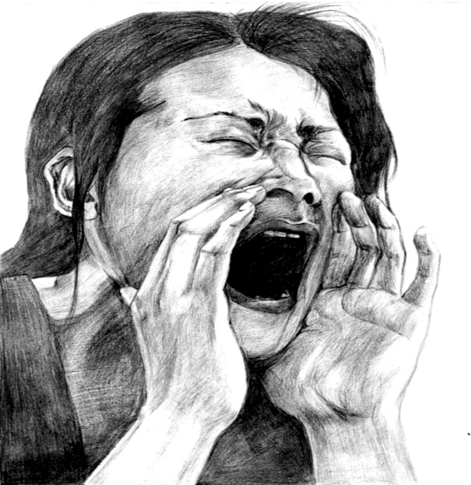
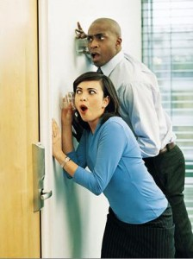
What do you hear…?

Slide 5
Do you take the time to listen before entering the courtroom?? * Do you hear a group of people.. * Do you hear raised voices.. * Do you hear swearing .. * Do you hear any threats..

Slide 6
Are you ready to open that door?
Be observant as you walk into the courtroom.
Do you hear anything that sounds physical?
Do you hear any verbal threats?

Slide 7
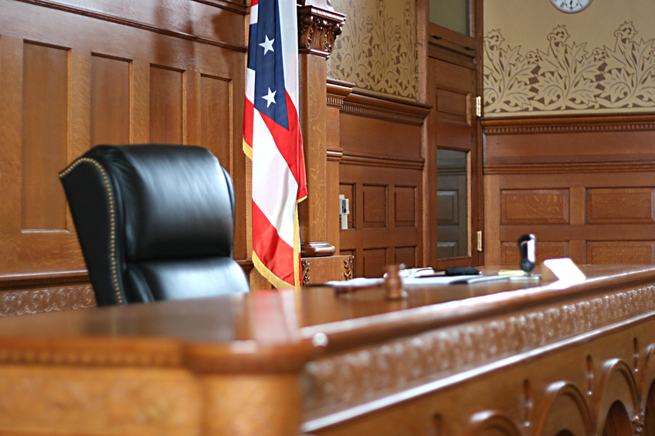
The decision to walk into the courtroom and take the bench is yours, but remember, safety of yourself and your staff is ”ALWAYS” top priority.

Slide 8
What is your focus, What do you see?

Slide 9
Primary focus is on the case itself. Do not fall into tunnel vision. Scan the courtroom from the bench. Do not lose sight on why a case may be in court.

Slide 10
“ It is only a simple Divorce Hearing”…..nothing to worry about ! How quickly things can happen ……..
https://www.youtube.com/watch?v=qDWMoHVumO8
Woman attacks the judge during court proceeding

Slide 11
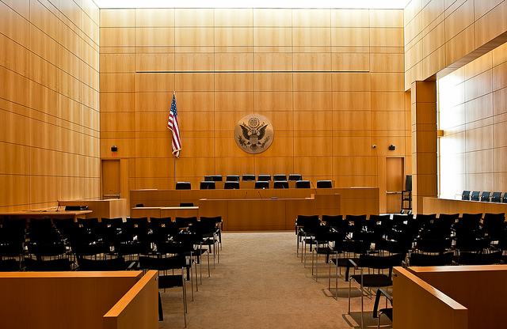
Look around and see who is in your courtroom. Should they be here?

Slide 12
https://www.youtube.com/watch?v=sBirvyzU9Do

Slide 13
If you see something you don’t like in the courtroom – remove it!
If you see someone that does not belong in the courtroom – ask them to leave!
If they refuse to leave – escort them out of the office/building!
Judge & Security staff have the ultimate authority to clear the courtroom

Slide 14
https://www.youtube.com/watch?v=AOFCwpXoN1U
4 dead, 2 injured – California Tribal Court shooting…

Slide 15
With drug addiction on the rise, never assume because you know the family, nothing could possibly go wrong. Tribal Courts are not Exempt from violence. It is not an if, only a when.

Slide 16
Thank you & Stay Safe!
Kimberly Maney
Forest County Potawatomi Tribal Court
Tribal Court Bailiff
(715) 478-7571
Kimberly.Maney@FCPotawatomi-nsn.gov

