Slide 1
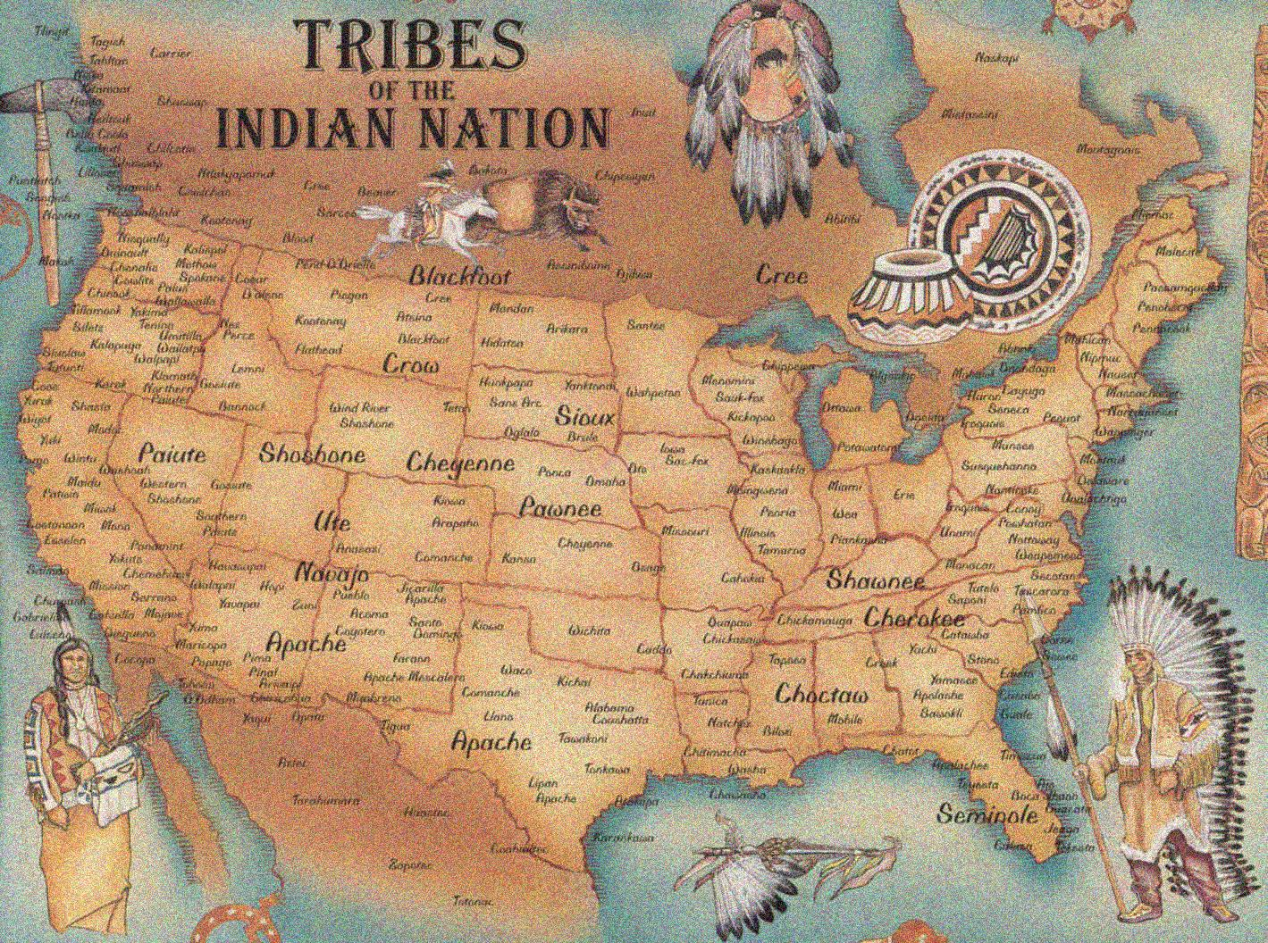
Sovereign Immunity

Slide 2
Tribal Sovereign Immunity
Suits against Indian tribes are barred by sovereign immunity absent a clear waiver by the tribe or congressional abrogation.
A waiver cannot be implied but must be unequivocally expressed
Santa Clara Pueblo v Martinez, 436 U.S. 49 (1978)
Oklahoma Tax Commission v Citizen Band of the Potawatomi Indian Tribe of Oklahoma, 498 U.S. 505 (1991)

Slide 3
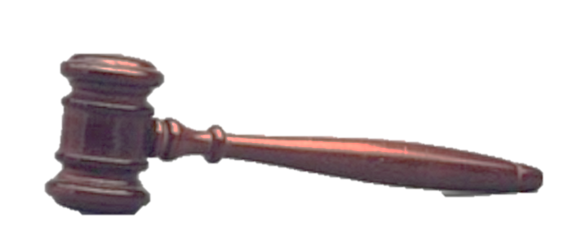
Tribes enjoy immunity from suits on contracts, whether those contracts involve governmental or commercial activities and whether they were made on or off a reservation
Kiowa Tribe of Oklahoma v Manufacturing Technologies, Inc., 523 U.S. 751 (1998)
The U.S. Supreme Court recently refused to overturn Kiowa, upholding its position that tribes enjoy immunity from suit even if the tribe’s activities are off reservation commercial activity
Michigan v Bay Mills Indian Community, 134 S.Ct. 2024 (2014)

Slide 4
In C & L Enterprises, Inc. v. Citizen Band of Potawatomi Indian Tribe of Oklahoma, 532 U.S. 411 (2001), the U.S. Supreme Court clarified that Congressional waivers of tribal immunity must be “unequivocally expressed”, while a tribe’s waiver of its immunity need only be “clear”.

Slide 5
Future of Tribal Sovereign Immunity
In Michigan v Bay Mills, the U.S. Supreme Court stated (5-4), “it is fundamentally Congress’s job, not ours, to determine whether or how to limit tribal immunity. The special brand of sovereignty the tribes retain-­‐both its nature and its extent-­‐rests in the hands of Congress.”

Slide 6
Wells Fargo Bank, N.A. v. Lake of the Torches Economic Development Corp.,
658 F.3d 684 (7th Cir. 2011)
Stifel, Nicolaus & Company, Inc., et al. v. Lac Du Flambeau Band of Lake Superior Chippewa Indians and Lake of the Torches Economic Development Corp. (pending 7th Circuit Court of Appeals)

Slide 7
Tribal corporation issued bonds to finance an off reservation gaming venture. Some of the contracts documenting the bond transaction included clearly expressed waiver of tribal sovereign immunity. The contract documents also included, however, provisions that triggered a management contract review by the National Indian Gaming Commission. No such approval was secured, rendering the transaction null and void, including any expressed waiver of immunity. This litigation is presently before the 7th Circuit Court of Appeals.

Slide 8
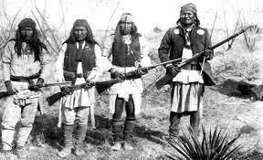
Tribal Law Impact on Waivers of Sovereign Immunity
Tribes enact laws that detail the specific manner in which a waiver of immunity can be accomplished: by written resolution only, with language that specifies what type of recovery is allowed or how much a recovery may be, or where a claim may be brought.
Sovereign immunity waiver in contract unenforceable where tribal law required a board of directors’ resolution to effect waiver and no resolution was passed. Memphis Biofuels, LLC v. Chickasaw Nation Indus., Inc.,585 F.3d 917 (6th Cir. 2009); Dilliner v. Seneca-­‐Cayuga Tribe of Oklahoma, 258 F3d. 516 (10th Cir. 2011)

Slide 9
MM&A Productions, LLC v. Yavapai-­‐Apache Nation, 234 Ariz. 60 (Court of Appeals of Arizona 2014)

Slide 10
“Likewise, we decline the invitation to apply apparent authority principles to waivers of sovereign immunity in order to ameliorate its effects, recognizing that ‘Indian sovereignty, like that of other sovereigns, is not a discretionary principle subject to the vagaries of the commercial bargaining process or the equities of a given situation.’” A casino marketing director signed a contract expressly waiving the Nation’s sovereign immunity. However, tribal law was not followed to give effect to the purported waiver of immunity.

Slide 11
“The Yavapai-­‐Apache Tribe hereby declares that, in exercising self-­‐determination and its sovereign powers to the fullest extent, the Tribe is immune from suit except to the extent that the Tribal Council expressly waives sovereign immunity, or as provided by this constitution.” Article XIII, Constitution of the Yavapai-­‐Apache Nation.

Slide 12
The Waiver of Sovereign Immunity in Arbitration Clauses
In C & L Enterprises, the U.S. Supreme Court held that by entering into a standard form contract copyrighted by the American Institute of Architects that included a clear arbitration provision, the tribe waived its immunity from suit.

Slide 13
Waiver of Sovereign Immunity in Web Based Agreements

Slide 14
Many vendor services require consent to online terms and conditions or “web-­‐based agreements”. Web-­‐based agreements typically include unfavorable choice of law provisions. Many include an arbitration provision, which the U.S. Supreme Court has held to be an express waiver of tribal sovereign immunity. In finding that the tribe clearly waived its immunity from suit by entering into the standard form American Institute of Architects contract with the arbitration provision, the Court in C & L Enterprises specifically found that the contract was not an adhesion contract and noted that the tribe proposed and prepared the contract.

Slide 15
Web-­‐based agreements are adhesion contracts and the tribe that clicks yes on the terms and conditions box has not prepared the contract. The holding in C & L Enterprises arguably does not apply in a dispute over whether a tribe has entered into a web-­‐based agreement that includes a typical arbitration clause. Also refer back to the issue of whether a putative waiver is given effect by complying with tribal law.

Slide 16
Sovereign Immunity Waivers of the Tribal Sub Entity
Whether an entity is entitled to sovereign immunity as an “arm of the tribe”, requires examination of several factors, including:
The method of creation of the economic entity
Its purpose
Its structure, ownership, and management, including the amount of control the tribe has over the entity
The tribe’s intent with respect to the sharing of its sovereign immunity
The financial relationship between the tribe and the entity
Breakthrough Mgmt. Group, Inc. v. Chukchansi Gold Casino and Resort, 629 F.3d 1173 (10th Cir. 2010).
See also, Matter of Ransom, 658 N.E.2d 989

Slide 17
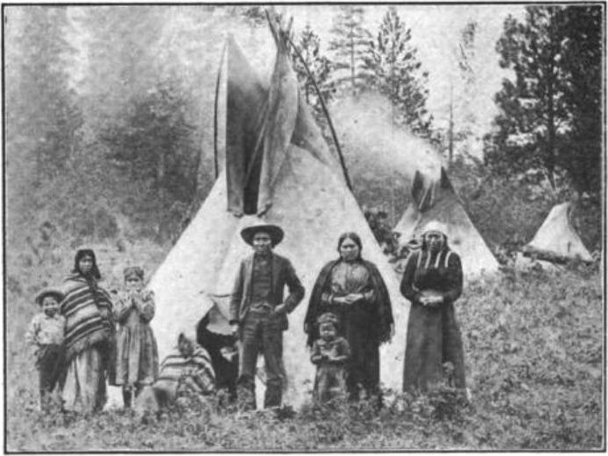
In short, protection of a tribal treasury against liability in a corporate charter is strong evidence against the retention of sovereign immunity by the corporation.
Sue/Perior Concrete & Paving, Inc. v. Lewiston Golf Course Corporation, 2014 WL 6633546

